Slide 1
Predicting Parkinson’s Disease for Patients Using Voice Recording
Jennifer Matas, Cesar Pinzon Gomez, Samantha Harrison, Kathryn Shahan & Sandra Ovuegbe

Slide 2
Background
Parkinson’s Disease: neurodegenerative disorder
Prevalence: ~ 572 per 100,000 people over the age of 45 in North America
Speech problems appear as one of earliest symptoms
Many machine learning models have been tested using vocal samples to predict Parkinson’s Disease
SVM with radial kernels, boosting
Notes:
Neurodegenerative disorders encompass a wide range of conditions that result from progressive damage to cells and nervous system connections that are essential for mobility, coordination, strength, sensation, and cognition.
Approximately 60,000 Americans are diagnosed with PD each year. More than 10 million people worldwide are living with PD.
SVM models with radial kernels and boosting are some of the most commonly used models for predicting PD.

Slide 3
Research objective: Test different machine learning methods in the prediction of Parkinson’s Disease using patient vocal samples

Slide 4
Methods: Model Choices
1
Support Vector Machine- Linear Boundaries
2
Support Vector Machine- Radial Boundaries
3
Random Forests
4
Boosting

Slide 5
Methods: Analysis
Evaluated for missing data
Viewed summary statistics and correlation
Tested each model using all features and top 50 features
Selected top 50 using minimum redundancy-maximum relevance (mRMR)
Split training set into subsets of training and test set
60/40 split
Standardization of predictors
Caret package
Used repeated 10-fold cross validation to tune parameters and select best models

Slide 6
Methods: Final Model Choice
Accuracy rate
Sensitivity and Specificity
Sensitivity: correctly classifies patient as diseased
Specificity: correctly classifies patient as not diseased
ROC Curve
Plots model performance
Aim: Selection of a model with high accuracy rate, good balance between sensitivity and specificity, and high ROC curve

Slide 7
Results: Dataset Overview
528 observations in original training set
267 females, 261 males
Subset sets (60/40 split):
Training set: n = 317
Test set: n =211
Class imbalance: 3:1 ratio of PD patients to non-PD
Final prediction test dataset: 228 observations with unknown PD
753 predictors
Many predictors were highly correlated (r >= |.80|)

Slide 8
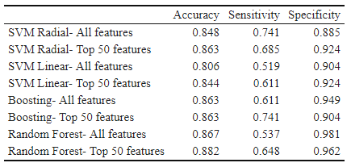
Results: Model Accuracy
Model accuracy, sensitivity and specificity rates on all features (753) and top 50 features:
Models on top 50 features generally produced higher accuracy rates
Less discrepancy between sensitivity and specificity
Notes:
Here, focus on us feeling comfortable in moving forward using top 50 features

Slide 9
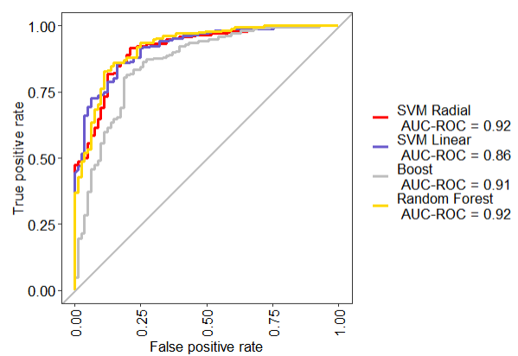
Results: ROC Curves
ROC curves with top 50 features:
SVM with radial kernels and 50 predictors was selected as the final Machine Learning strategy
Test accuracy: 0.863
Sensitivity: 0.685, specificity: 0.885
Notes:
Main point: selection of final model

Slide 10
Discussion: Limitations
Class imbalance
Can compromise accuracies
High-dimensional data
Multicollinearity and overfitting
Addressed with feature selection
Failure to account for repeated measurements
Can yield biased results
Could have been addressed by splitting sets by ID number

Slide 11
Discussion: Implications
Support Vector Machines with radial kernels may be an appropriate ML method for predicting Parkinson’s disease
Consistent with other literature
Importance of effectively working with high-dimensional data
Models using only 50 features consistently performed the same or better than those with all features
Step forward in Parkinson’s research
Future research can investigate further applications of model

Slide 12
References
Marras C, Beck JC, Bower JH, et al. Prevalence of Parkinson’s disease across North America. NPJ Park Dis. 2018;4(21):1-7. doi:10.1038/s41531-018-0058-0
Tysnes O-B, Storstein A. Epidemiology of Parkinson’s disease. J Neural Transm. 2017;124:901-905. doi:10.1007/s00702-017-1686-y
Sakar BE, Serbes G, Sakar CO. Analyzing the effectiveness of vocal features in early telediagnosis of Parkinson’s disease. PLoS One. 2017;12(8):1-18. doi:10.1371/journal.pone.0182428
Reid J, Parmar P, Lund T, Aalto DK, Jeffery CC. Development of a machine-learning based voice disorder screening tool. Am J Otolaryngol - Head Neck Med Surg. 2022;43(2):103327. doi:10.1016/j.amjoto.2021.103327
Singh J, Rajnish R, Singh DK. Designing a Machine Learning Model to Predict Parkinson’s Disease from Voice Recordings. In: Luhach AK, Poonia RC, Gao X-Z, Jat DS, eds. Second International Conference on Sustainable Technologies for Computational Intelligence. Advances in Intelligent Systems and Computing. Springer; 2022:95-103.
Nissar I, Rizvi DR, Masood S, Mir AN. Voice-based detection of parkinson’s disease through ensemble machine learning approach: A performance study. EAI Endorsed Trans Pervasive Heal Technol. 2019;5(19):1-8. doi:10.4108/eai.13-7-2018.162806
De Jay N, Papillon-Cavanagh S, Olsen C, El-Hachem N, Bontempi G, Haibe-Kains B. MRMRe: An R package for parallelized mRMR ensemble feature selection. Bioinformatics. 2013;29(18):2365-2368. doi:10.1093/bioinformatics/btt383

Slide 13
References
8. Parikh R, Mathai A, Parikh S, Sekhar C, Thomas R. Understanding and using sensitivity, specificity and predictive values. Indian J Ophthalmol. 2008;56(4):341. doi:10.4103/0301-4738.41424
9. Max A, Wing J, Weston S, et al. Package ‘ Caret ’ R Topics Documented :; 2022. https://cran.r-project.org/web/packages/caret/caret.pdf
10. Liu L, Chen L, Zhang YH, et al. Analysis and prediction of drug–drug interaction by minimum redundancy maximum relevance and incremental feature selection. J Biomol Struct Dyn. 2017;35(2):312-329. doi:10.1080/07391102.2016.1138142
11. Radovic M, Ghalwash M, Filipovic N, Obradovic Z. Minimum redundancy maximum relevance feature selection approach for temporal gene expression data. doi:10.1186/s12859-016-1423-9
12. Toğaçar M, Ergen B, Cömert Z. Detection of lung cancer on chest CT images using minimum redundancy maximum relevance feature selection method with convolutional neural networks. Biocybern Biomed Eng. 2020;40(1):23-39. doi:10.1016/J.BBE.2019.11.004
13. Wu S. Multicollinearity in Regression. Towards Data Science. Published 2020. Accessed April 14, 2022. https://towardsdatascience.com/multi-collinearity-in-regression-fe7a2c1467ea
14. Raghuwanshi BS, Shukla S. Class-specific extreme learning machine for handling binary class imbalance problem. Neural Networks. 2018;105:206-217. doi:10.1016/j.neunet.2018.05.011
15. Martin D. Handling Class Imbalance with R and Caret - An Introduction. Published 2016. Accessed April 12, 2022. https://dpmartin42.github.io/posts/r/imbalanced-classes-part-1

Slide 14
Questions?

Slide 15
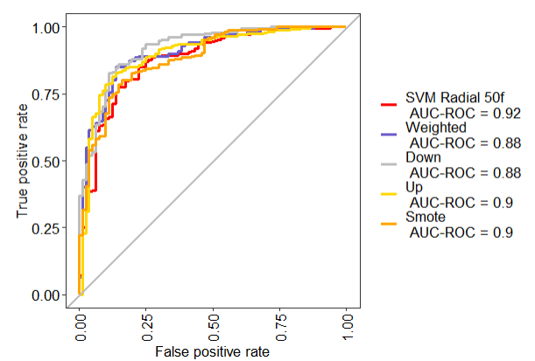
Appendix: Class imbalance ROC Curve
ROC Curve after applying methods to reduce class imbalance

